Slide 1
Flash Analog-to-Digital Converter ECE 532 Project
Jiahui Yang Bingyu Zhang

Slide 2

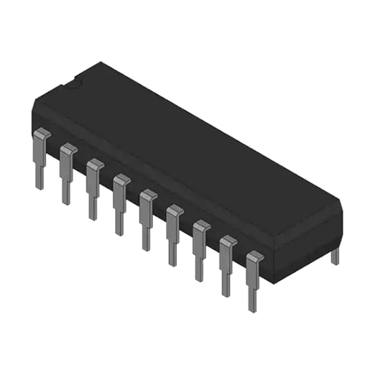
Introduction
Flash ADC is the fastest type of analog-to-digital converter (ADC), utilizing a parallel comparison method to convert an analog signal into a digital output within a single clock cycle.
Advantages✅
Extremely fast conversion speed
No latency
Ideal for high-frequency applications
Disadvantages❌
Hardware complexity grows exponentially
High power consumption
Limited resolution

Slide 3
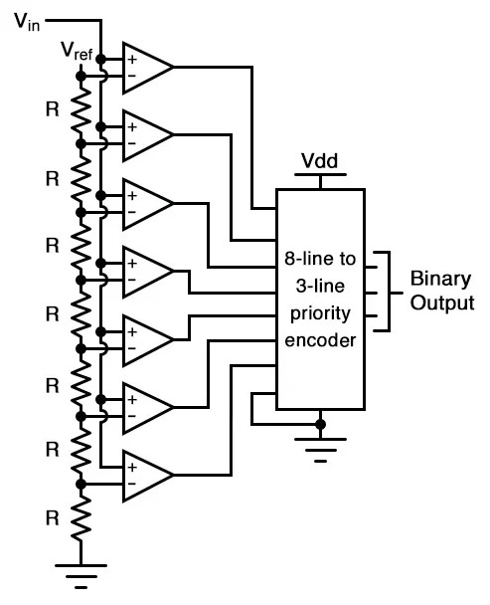
Structure of Flash ADC
It consists of 3 main components:
Resistor Ladder (Voltage Divider)
Comparator Array
Priority Encoder

Slide 4
Resistor Ladder
A series of resistors divides the reference voltage (V_{ref}​) into 2^{𝑁}−1 discrete voltage levels. These reference voltages are fed into the comparator array.

Slide 5
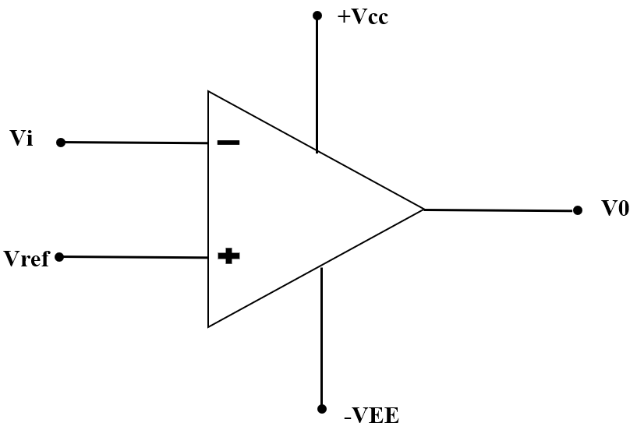
Comparator Array
Each comparator compares the input voltage (𝑉_{in}) with a corresponding reference voltage:
If 𝑉_{in} > 𝑉_{ref} , the comparator outputs high (1)
If 𝑉_{in} < 𝑉_{ref} , the comparator outputs low (0)
This process generates a thermometer code.

Slide 6
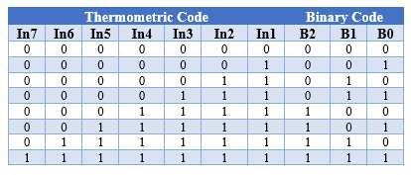
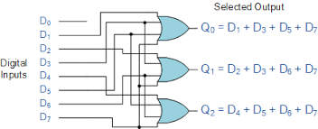
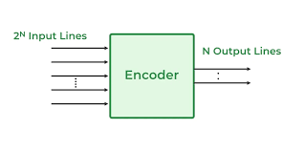
Priority Encoder
Converts the thermometer code into a binary code.

Slide 7
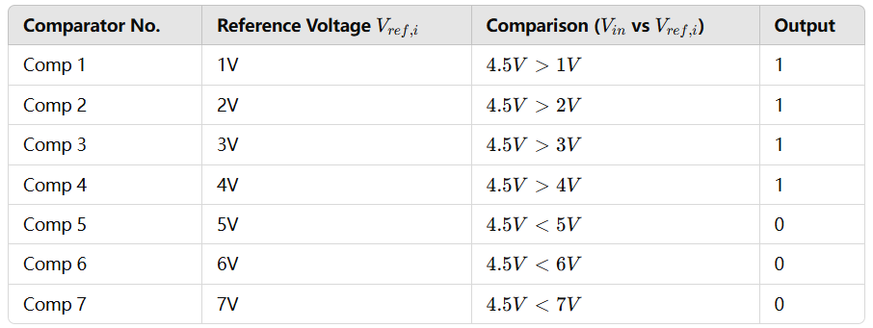
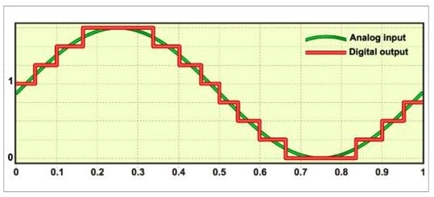

Example: 3-bit Flash ADC
Given a reference voltage range of 0V - 7V, the resistor ladder generates 7 reference voltages:
1V, 1V, 2V, 3V … 7V
Assume the input voltage is V_{in}​ =4.5V

Slide 8
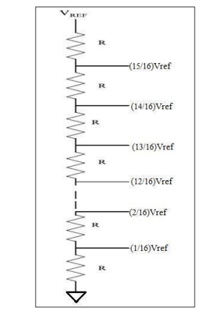
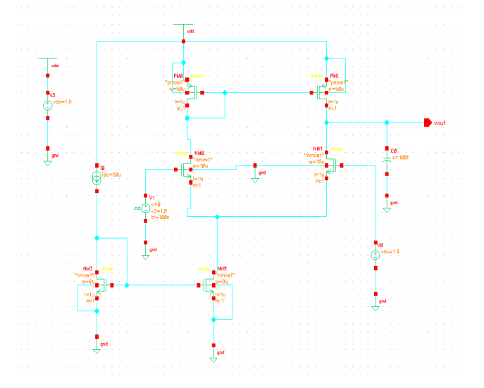
4-bit Flash ADC Schematic – Analog + Digital
Priority Encoder
Digital
Resistor Ladder
Analog
Differential Comparator
Analog

Slide 9
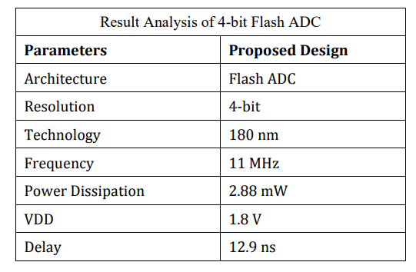
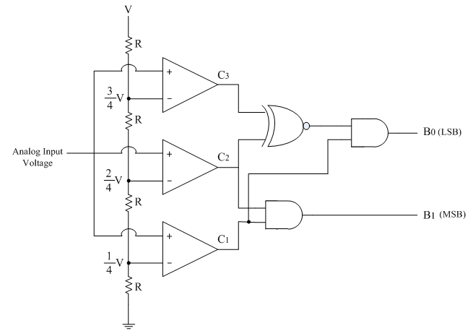
Schedule of Design Tasks
Schematic Design
Resistor Ladder (Jiahui)
Comparator (Jiahui & Bingyu)
Encoder (Bingyu)
Layout Design
Resistor Ladder (Jiahui)
Comparator (Jiahui & Bingyu)
Encoder (Bingyu)
Testing
With DC inputs (Together)
With Sine wave input (Together)

Slide 10
Thanks

